Slide 1
Meeting Week 11
Last week summary
Simulation parameter recovery
Augmentation additional state
Outline ToDo next week

Slide 2
Last week summary
LPV (-LFR)
  Currently not making not use of LFR structure. LFR structure is beneficial for control design, even with black box components.

Slide 3
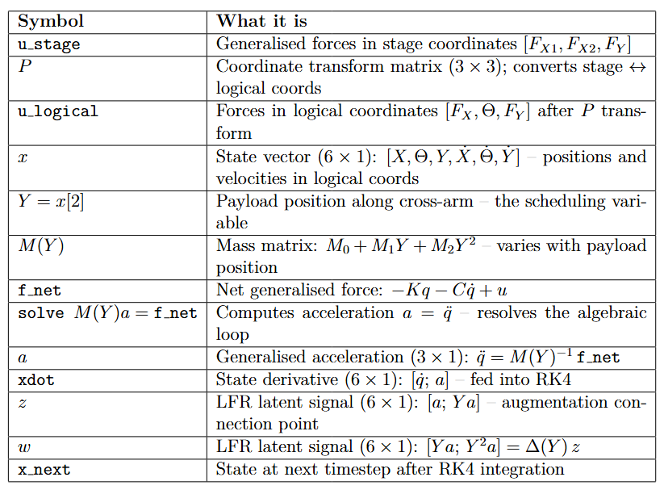
u_stage
P transform
u_transformed
X, Y, Physical parameters
lfr_forward
Solve a = M(Y)^-1 f_net
← M(Y) = M0 + M1 Y + M2 Y^2
Y = x[2] (self-scheduling)
Xdot
z
w
← z, w retained
X0 = [0, 0, 0.3, 0, 0, 0]
[x 4 RK4 sub-steps]
X_next
Notes:
Our model is CT LPV-LFR use RK4 to discretize it
The forward solves the “algebraic loop”
Calculate 4 different x states, determine x_next based on that / discretization method

Slide 4
u_stage
P transform
u_transformed
X, Y, Physical parameters
lfr_forward
Solve a = M(Y)^-1 f_net
← M(Y) = M0 + M1 Y + M2 Y^2
Y = x[2] (self-scheduling)
k1, z, w, y = lfr_forward(x, ...)
x2 = x + (ts / 2) * k1
k2, _, _, _ = lfr_forward(x2, ...)
x3 = x + (ts / 2) * k2
k3, _, _, _ = lfr_forward(x3, ...)
x4 = x + ts * k3
k4, _, _, _ = lfr_forward(x4, ...)
x_next = x + (ts / 6) * (k1 + 2 * k2 + 2 * k3 + k4)
xdot
z
w
← z, w retained
[x 4 RK4 sub-steps]
x_next
Notes:
Also worth noting for the diagram: z and w are only retained
from the k1 call (at the actual state x[k]). The other 3 calls
discard z, w (they get _). So the diagram should show z and w
branching off from k1 only.
- k1: at the current state x[k] — the start of the step
- k2: at x + (ts/2)·k1 — a half-step ahead using k1 as the slope
- k3: at x + (ts/2)·k2 — a half-step ahead using k2 as the slope
- k4: at x + ts·k3 — a full step ahead using k3 as the slope
So k2, k3, k4 are evaluated at temporary/intermediate states
that are never stored — they exist only to get a better estimate
of the average slope over the interval. Then all four slope
estimates are combined:
x_next = x + (ts/6) * (k1 + 2·k2 + 2·k3 + k4)

Slide 5
u_stage
P transform
u_transformed
X, Y, Physical parameters
lfr_forward
Solve a = M(Y)^-1 f_net
← M(Y) = M0 + M1 Y + M2 Y^2
Y = x[2] (self-scheduling)
ts = 1/20000 = 50 μs, corresponding to fs = 20 kHz.
This matches the PLTI (Position Loop Time Interval) from the AccurET hardware specification.
k1, z, w, y = lfr_forward(x, ...)
x2 = x + (ts / 2) * k1
k2, _, _, _ = lfr_forward(x2, ...)
x3 = x + (ts / 2) * k2
k3, _, _, _ = lfr_forward(x3, ...)
x4 = x + ts * k3
k4, _, _, _ = lfr_forward(x4, ...)
x_next = x + (ts / 6) * (k1 + 2 * k2 + 2 * k3 + k4)
xdot
z
w
← z, w retained
[x 4 RK4 sub-steps]
x_next
Notes:
Z,w useful for augmentation, currently not used explicitly
Also worth noting for the diagram: z and w are only retained
from the k1 call (at the actual state x[k]). The other 3 calls
discard z, w (they get _). So the diagram should show z and w
branching off from k1 only.
- k1: at the current state x[k] — the start of the step
- k2: at x + (ts/2)·k1 — a half-step ahead using k1 as the slope
- k3: at x + (ts/2)·k2 — a half-step ahead using k2 as the slope
- k4: at x + ts·k3 — a full step ahead using k3 as the slope
So k2, k3, k4 are evaluated at temporary/intermediate states
that are never stored — they exist only to get a better estimate
of the average slope over the interval. Then all four slope
estimates are combined:
x_next = x + (ts/6) * (k1 + 2·k2 + 2·k3 + k4)

Slide 6
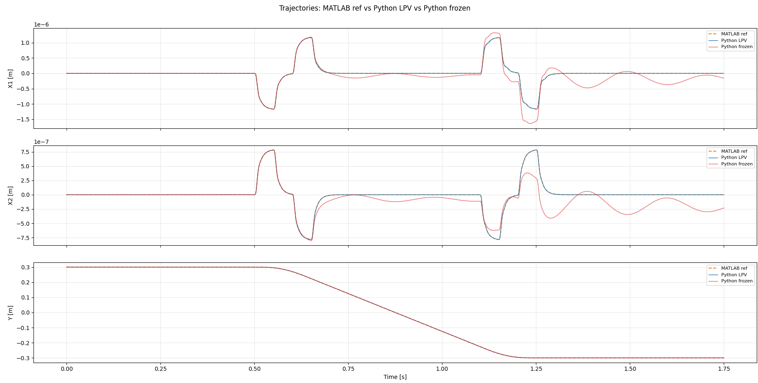
Simulation – Trajectory

Slide 7
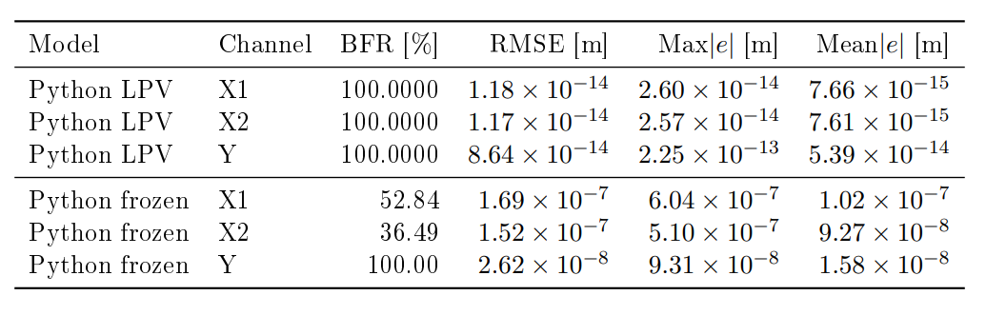
Validation results: Python LPV and frozen LTI vs MATLAB q1 reference. All models driven by u_q1 forces. Y range: -0.3 to +0.3 m.
Reference for X1 and X2 are set to zero.

Slide 8
LPV-LFR
Proof invertibility
  Analytical Schur complement
  And matlab symbolic toolbox verified. How …?
Proof / Rewrite rational/polynomial expression for I-Dzw*delta(Y)
Also equivalene for SVD. That if the I6 suffices also the I4 latent channel suffices.
  Sylvester’s / identify??

Slide 9
Simulation – Parameter recovery
Stratified random sampling
Batching
Gradient

Slide 10
Stratified random sampling
Problem: total trajectory is too long (35001 steps) to train in one pass → solution: split it into segments (8 × 4000 per epoch)
  Divided into 4375 × 8 separate parts, but per epoch only 4000
    This allows to have different starting positions, don’t see the same segment every epoch
Stratified guarantees every part of the trajectory is seen every epoch over pure random

Slide 11
Batching
Multiple shooting
  Batch: each epoch processes all n=8 segments simulated in parallel
Each segment starts from a precomputed state (position + velocity from data)
  Positions are taken directly from q1 (measured). Velocities are not measured they are computed via central differences

Slide 12
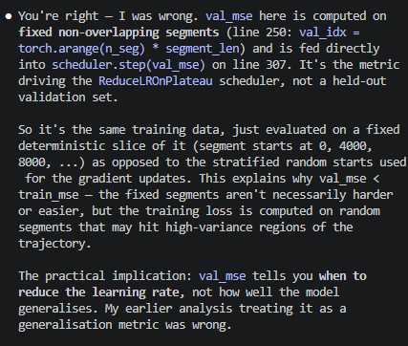
Gradient
Gradient computation
  Loss = MSE(predicted positions, measured positions)
  All 8 segments contribute, averaged before parameter updating
Adam optimizer
  Adam optimizes over the 13 parameters in log space (to guarantee M(Y) is invertible because all parameters > 0 )
Notes:
Gradient Computation
simulate() rolls out RK4 over each segment with bptt_mode='full' — full backpropagation
through time (BPTT) through all segment_len steps. The gradient flows through simulate →
_build_matrices → _recover_params → log_params (the single trainable nn.Parameter).
Gradient flows back through the RK4 simulation (full BPTT over 4000 steps per segment)
to log_params
Looks at MSE but also looks at how the develops over multiple…
Val for tuning learning rate… -->> stratisfied sampling balab

Slide 13
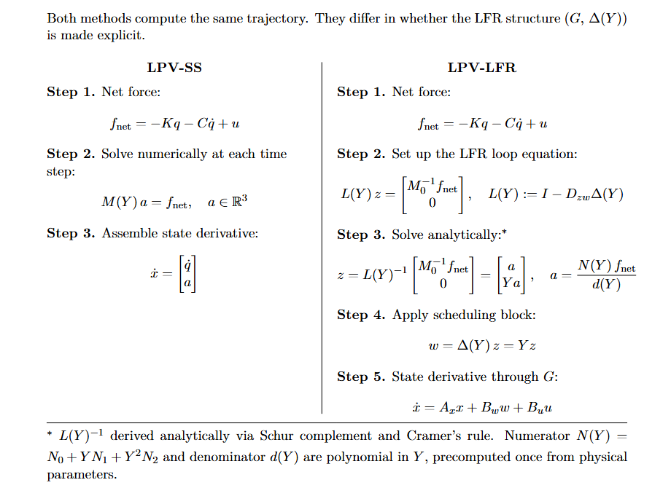
LPV-SS vs. LPV-LFR Forward Pass

Slide 14
Simulation – Parameter recovery
ASMPT feedback
  Multi shoot for parameter
  Multiple trajectories for identifiability
Run locally, but crashed between 100-200 epochs

Slide 15
Augmentation – Additional state
Lagrange-Euler
  Mimic Garcia paper for additional MSD
  Used symbolic toolbox to do the Euler step
    Wrote down the kinematic formulas and added to existing Garcia derived for current matrices
Verify with adding MSD to provided Simulink model of the gantry.

Slide 16
Augmentation – Additional state
Requirements
Suggestion
Implementation

Slide 17
Requirements
New state should not be measured directly.
Structurally non-absorbable by the rigid baseline
The effect of the added state must be visible enough in the measured signals for the augmentation to detect it
Physically interpretable
Notes:
Hidden from the output
(if I plant o add noise SNR: compare hidden-state contribution to noise
map:

Slide 18
Requirements
New state should not be measured directly.
  Indirect visible through dynamics: We only see the effect of it / it disturbs the measured motion
Structurally non-absorbable by the rigid baseline (hard to quantify)
  The original baseline model can’t fake the effect by changing its parameter values → the baseline would need to add states to imitate it
The effect of the added state must be visible enough in the measured signals for the augmentation to detect it
  Could be quantified before implementing augmentation:
    Relative output contribution compared to total measured motion
    Residual of best re-identified model after refitting the baseline parameters on data
Physically interpretable
  Relevant to the gantry
Notes:
Hidden from the output
(if I plant o add noise SNR: compare hidden-state contribution to noise
map:

Slide 19
Suggestion
Additional Mass Spring Damper attached to payload mass (mh)
  Position and velocity as additional states
  Similar to Jan adding MSD
  I can justify it with a sensor or camera

Slide 20

Comparison with Jan

Slide 21
Comparison with Jan
With p3 the position of the additional mass - not measured

Slide 22


Slide 24
Note:
Picture is not fully accurate, we define the mass as the relative displacement from mh currently
Will need to add offset

Slide 25

Lagrange-Euler - Garcia

Slide 26

Lagrange-Euler - Garcia

Slide 27
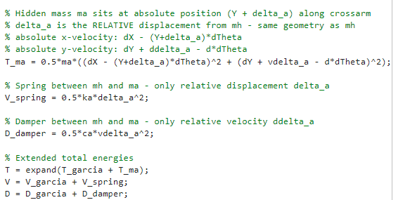
Lagrange-Euler – Additional state
Notes:
Why $T_{ma}$Has No $J_{a}$Term
$m_{a}$is modeled as a point mass — it has no rotational inertia about its own center of mass.
Linear spring: linear spring potential energy
Jan also has linear spring…?

Slide 28
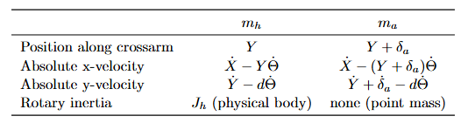
Lagrange-Euler – Additional state
Notes:
Why $T_{ma}$Has No $J_{a}$Term
$m_{a}$is modeled as a point mass — it has no rotational inertia about its own center of mass.
Linear spring: linear spring potential energy
Jan also has linear spring…?

Slide 29
Lagrange-Euler – Additional state
Notes:
Why $T_{ma}$Has No $J_{a}$Term
$m_{a}$is modeled as a point mass — it has no rotational inertia about its own center of mass.
Linear spring: linear spring potential energy
Jan also has linear spring…?

Slide 30
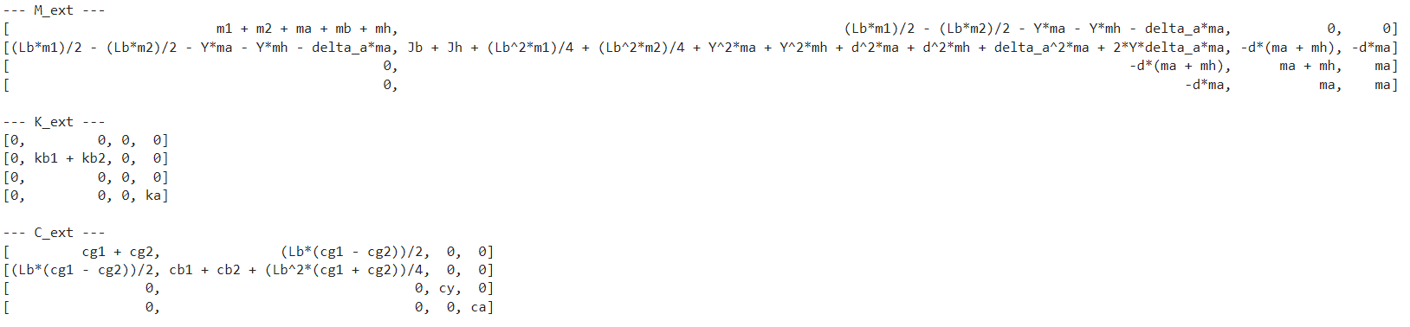
Symbolic toolbox result
4th row and 4th column is the addition of the additional state delta_a

Slide 31
Additional state – To do
Verify with simscape model
Add offset

Slide 32
Outline next week
Write out proof for invertibility I-Dzw*delta(Y) with the Schur complement
Write out proof for equivalence SVD dimensionality reduced with Sylvester’s determinant identity
Validate additional state with simscape
Simulation ensure proper identification for parameter recovery

Slide 33
LPV-LFR rational & Well-posed & SVD equivalance & Additional state
And Gantt chart!

Slide 34
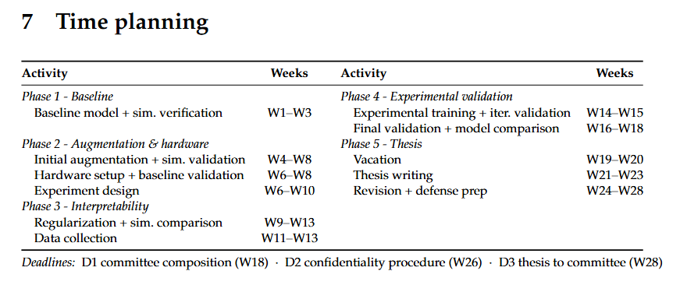
Planning – Week 3

Slide 35
Planning – Week 3

